Slide 1
CSC 302 Midterm Presentation
Alcohol Consumption in relation to
Suicide Rate, Income, Employment & Urban Rate
By: Austin Tetlow, Brent Vespa, Sydney Wright
Notes:
Sydney

Slide 2
Introduction
Our dataframe is from https://www.kaggle.com/sansuthi/alcohol-consumption
We chose this dataframe because it provided insight into alcohol consumption and other interesting factors that we thought could find correlation between.
Notes:
Sydney

Slide 3
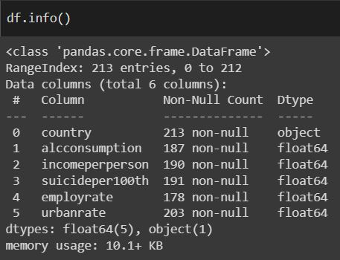
Variables
Country - String
Alcohol - Float
Income Per Person - Float
Suicide per 100 - Float
Employment Rate - Float
Urban Rate - Float
Notes:
Austin

Slide 4
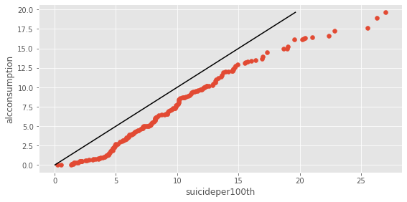
Seaborn QQ - Alcohol Consumption in relation to Suicides Per 100th.
Notes:
Austin

Slide 5
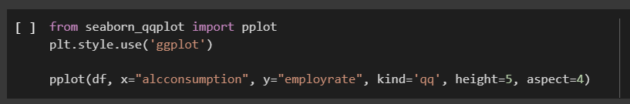
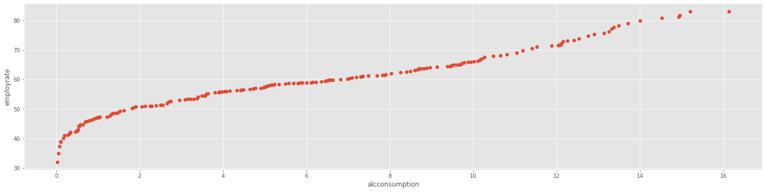
Seaborn QQ - Alcohol Consumption in relation to Employment Rate
Notes:
Brent

Slide 6
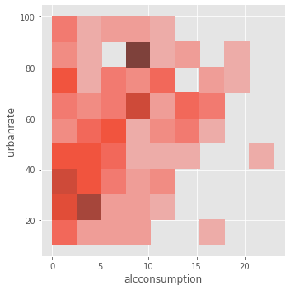

Seaborn Displot Heat Map- Alcohol Consumption in relation to Urban Rate
One of the correlations viewable is a high correlation between low alcohol consumption and urban rate, with a diminishing correlation at higher alcohol consumptions.
Notes:
Brent

Slide 7
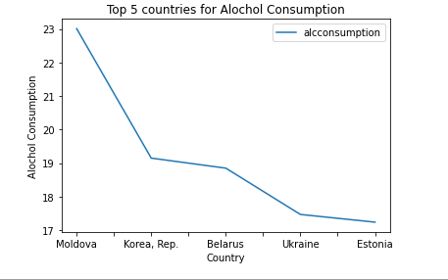

Pandas DataFrame plot (line) -
Top 5 countries and their alcohol consumption rate
Alcohol consumption per adult (age 15+), litres Recorded and estimated average alcohol consumption, adult (15+) per capita consumption in litres pure alcohol
This graph shows the top 5 countries and their alcohol consumption. The top country, Moldova, as shown, has a substantial lead in alcohol consumption to even the next country, Korea.
Notes:
Sydney

Slide 8

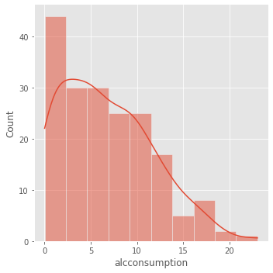
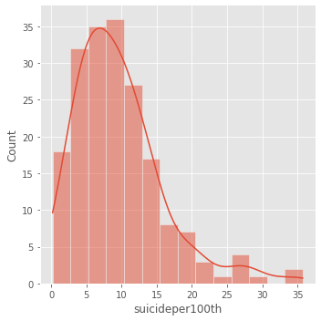
Seaborn Displot KDE-
Alcohol Consumption and Suicide Rate
Both graphics of Alcohol Consumption and Suicide Per 100, share the same type of curves in their numbers tapering off at higher values.
Notes:
Brent

